Slide 1

UNIVERSITY INSTITUTE OF ENGINEERING
DEPARTMENT OF AIT - CSE
Bachelor of Engineering (CSE)
Security and Data Privacy Laws and Standards (21CSF-433)
By: Ms. Merry K.P(E12903)
Assistant Professor
AIT CSE
Lecture -3
Assurance in the Trusted Operating System
DISCOVER . LEARN . EMPOWER

Slide 2
Chapter | Course Objectives
1. | Exhibit knowledge to secure corrupted systems, protect personal data, and secure computer networks in an organization.
Chapter | Course Outcomes
1. | After completion of this course, the student will be able to Know how to secure corrupted systems. Aware of personal data protection and secured networking.

Slide 3
Contents
1.1 Designing Trusted Operating Systems
Assurance in Trusted operating system

Slide 4
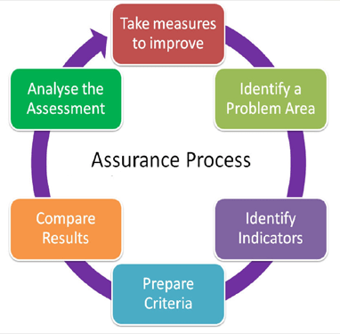
Assurance in Trusted Operating Systems
For an operating system designed to be secure, assurance is the key for convincing others that the security model is correct, as the design and implementation of the OS.
How does one gain confidence that an operating system should be trusted? One way is by gaining confidence that a number of the more obvious security vulnerabilities have been addressed in the system's design.

Slide 5
Assurance in Trusted Operating Systems
Input/Output processing represents one of the larger vulnerabilities in operating systems. There are a number of reasons for the vulnerability of this processing, including
1) the fact that I/O processing is interrupt driven, and
2) the fact that I/O processing is often performed by independent hardware systems, and
3) the complexity of the I/O code itself, and
4) the desire to have the I/O process bypass the security monitors as an efficiency issue.

Slide 6
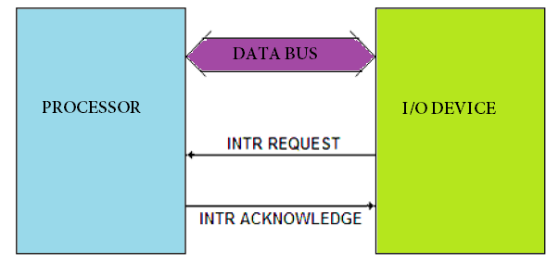
Assurance in Trusted Operating Systems
Input/Output Processing represents one of the more considerable vulnerabilities in operating systems. There are several reasons for the vulnerability of this processing, including
I/O processing is interrupt-driven
Independent hardware systems frequently perform I/O processing
The complexity of the I/O code itself
The desire to have the I/O process bypass
the security monitors is an efficiency issue.

Slide 7
Assurance Methods
Once we understand the potential vulnerabilities in a system, we can apply assurance techniques to seek out the vulnerabilities and mitigate or eliminate their effects.
In this section, we consider three such techniques, showing how they give us confidence in a system's correctness:
Testing
Verification
Validation
None of these is complete or foolproof, and each has advantages and disadvantages. However, used with understanding, each can play an important role in deriving overall assurance of the systems' security.

Slide 8
Testing
Testing is the most widely accepted assurance technique.
As Boebert [BOE92] observes, conclusions from testing are based on the actual product being evaluated, not on some abstraction or precursor of the product. This realism is a security advantage.
However, conclusions based on testing are necessarily limited, for the following reasons:
Testing can demonstrate the existence of a problem, but passing tests does not demonstrate the absence of problems.
Testing adequately within reasonable time or effort is difficult because the combinatorial explosion of inputs and internal states makes testing very complex

Slide 9
Cont…
Testing based only on observable effects, not on the internal structure of a product, does not ensure any degree of completeness.
Testing based on the internal structure of a product involves modifying the product by adding code to extract and display internal states. That extra functionality affects the product's behavior and can itself be a source of vulnerabilities or mask other vulnerabilities.
Testing real-time or complex systems presents the problem of keeping track of all states and triggers. This problem makes it hard to reproduce and analyze problems reported as testers proceed.

Slide 10
Penetration Testing
A testing strategy often used in computer security is called penetration testing, tiger team analysis, or ethical hacking.
In this approach, a team of experts in the use and design of operating systems tries to crack the system being tested.
The tiger team knows well the typical vulnerabilities in operating systems and computing systems.
With this knowledge, the team attempts to identify and exploit the system's particular vulnerabilities. The work of penetration testers closely resembles what an actual attacker might do.

Slide 11
Cont…
Penetration testing is both an art and a science. The artistic side requires careful analysis and creativity in choosing the test cases. But the scientific side requires rigor, order, precision, and organization.
As Weismann observes [WEI95], there is an organized methodology for hypothesizing and verifying flaws. It is not, as some might assume, a random punching contest.
Using penetration testing is much like asking a mechanic to look over a used car on a sales lot.
The mechanic knows potential weak spots and checks as many of them as possible. It is likely that a good mechanic will find significant problems, but finding a problem (and fixing it) is no guarantee that no other problems are lurking in other parts of the system.

Slide 12
Cont…
For instance, if the mechanic checks the fuel system, the cooling system, and the brakes, there is no guarantee that the muffler is good.
In the same way, an operating system that fails a penetration test is known to have faults, but a system that does not fail is not guaranteed to be fault-free. Nevertheless, penetration testing is useful and often finds faults that might have been overlooked by other forms of testing.
One possible reason for the success of penetration testing is its use under real-life conditions. Users often exercise a system in ways that its designers never anticipated or intended.
So penetration testers can exploit this real-life environment and knowledge to make certain kinds of problems visible.

Slide 13
Cont…
Penetration testing is popular with the commercial community who think skilled hackers will test (attack) a site and find problems in hours if not days.
These people do not realize that finding flaws in complex code can take weeks if not months. Indeed, the original military red teams to test security in software systems were convened for 4- to 6-month exercises.
To find one flaw in a space of 1 million inputs may require testing all 1 million possibilities; unless the space is reasonably limited, this search is prohibitive.
Penetration testing is not a magic technique for finding needles in haystacks.

Slide 14
Formal Evaluation
We now turn to formal evaluation of an operating system against a published set of criteria. One of the earliest attempts for formal evaluation was called the Trusted Computer System Evaluation Criteria (TCSEC), more loosely the “Orange Book” because that was the color of the book. This was published in the late 1970’s by the U. S. Department of Defense. The TCSEC defined a number of levels of assurance.
D – basically, no protection. Any system can get this level.
C1 – discretionary access control
C2 – controlled access protection ( a finer grained discretionary access control)
B1 – labeled security protection
Each object is assigned a security level and mandatory access controls are used.
B2 – structured protection. This is level B1 with formal testing of a verified design.
B3 – security domains. The security kernel must be small and testable.
A1 – verified design. A formal design exists and has been thoroughly examined.

Slide 15
Formal Verification
The most rigorous method of analyzing security is through formal verification,
Formal verification uses rules of mathematical logic to demonstrate that a system has certain security properties.
In formal verification, the operating system is modeled and the operating system principles are described as assertions.

Slide 16
Cont…
The collection of models and assertions is viewed as a theorem, which is then proven. The theorem asserts that the operating system is correct.
That is, formal verification confirms that the operating system provides the security features it should and nothing else.
Proving correctness of an entire operating system is a formidable task, often requiring months or even years of effort by several people. Computer programs called theorem provers can assist in this effort, although much human activity is still needed.

Slide 17
Validation
Formal verification is a particular instance of the more general approach to assuring correctness: verification.
Validation is the counterpart to verification, assuring that the system developers have implemented all requirements. Thus, validation makes sure that the developer is building the right product (according to the specification), and verification checks the quality of the implementation.

Slide 18
Validation
There are several different ways to validate an operating system.
Requirements Checking.
One technique is to cross-check each operating system requirement with the system's source code or execution-time behavior.
The goal is to demonstrate that the system does each thing listed in the functional requirements. This process is a narrow one, in the sense that it demonstrates only that the system does everything it should do.
In security, we are equally concerned about prevention: making sure the system does not do the things it is not supposed to do.
Requirements checking seldom addresses this aspect of requirements compliance.

Slide 19
Validation
Design and Code Reviews
Design and code reviews usually address system correctness (that is, verification). But a review can also address requirements implementation.
To support validation, the reviewers scrutinize the design or the code to ensure traceability from each requirement to design and code components, noting problems along the way (including faults, incorrect assumptions, incomplete or inconsistent behavior, or faulty logic).
The success of this process depends on the rigor of the review.

Slide 20
Validation
System Testing.
The programmers or an independent test team select data to check the system.
These test data can be organized much like acceptance testing, so behaviors and data expected from reading the requirements document can be confirmed in the actual running of the system.
The checking is done in a methodical manner to ensure completeness.

Slide 21
Summary
Need of assurance in Trusted Operating System (TOS)

Slide 22
Home Work
Q1. What is the need for data integrity in TOS?
Q2. What do you mean by end-user testing?

Slide 23
References
Text Books:
V. D. Dudeja ,”Cyber Crime and Law Enforcement”, Commonwealth Publishers, 2003.
C. Davis,”IT Auditing: Using Controls to protect Information Assets”, TMH, 2011.
Reference Books:
G.E. Kennedy & L.S.P. Prabhu, “Data Privacy Law: A Practical Guide”, Interstice; 2nd edition, 2017.
June M. Sullivan & Shannon B. Hartsfield, “HIPAA: A Practical Guide to the Privacy and Security of Health Data”, American Bar Association; 2nd edition, 2020.
Journals:
Pankaj Sharma, “Cyber Surveillance & Data Privacy Law: The Reconciliation”, https://www.researchgate.net/publication/335378068_Cyber_Surveillance_Data_Privacy_Law_The_Reconciliation?channel=doi&linkId=5d60da79a6fdccc32cccd626&showFulltext=true, 2019.
Online References:
Infrastructure Security || module 2|| Software Security || Database Integrity & Reliability:
https://www.youtube.com/watch?v=gDO61Ixz_-E

Slide 24
THANK YOU
For queries
Email: merry.e12903@cumail.in

